Slide 1
Selenium
Senthil Natarajan
Please Join in below link
Instagram: https://www.instagram.com/rba_infotech/
LinkedIn: https://www.linkedin.com/company/rba-infotech/
Facebook: https://www.facebook.com/people/RBA-Infotech/100043552406579/

Slide 2
What is Automation Testing?
Automated testing
The process of validating if software is functioning appropriately and meeting requirements before it is released into production by Software Testing Automation Tools is called Automation Testing. Few of the best automation tools are
Selenium
UFT – Unified Functional Tester (Advanced version of QTP)
RFT – Rational Functional Tester (IBM)
Playwright - Microsoft
Waitr
SilkTest
Ranorex Studio
Kobiton
ZAPTEST
Lambda Test

Slide 3
Advantages of Automation Testing
Following are the Advantages of Automation Testing:
70% faster than the manual testing
Wider test coverage of application features
Reliable in results
Ensure Consistency
Saves Time and Cost
Improves accuracy
Human Intervention is not required while execution
Increases Efficiency
Better speed in executing tests
Re-usable test scripts
Test Frequently and thoroughly
More cycle of execution can be achieved through automation
Early time to market

Slide 4
Criteria for Automation or When automation is suggested?
The following are the criteria to go for Automation:
High Risk – Business Critical test cases
Test cases that are repeatedly executed
Test Cases that are very tedious or difficult to perform manually
Test Cases which are time-consuming
The following category of test cases are not suitable for automation:
Test Cases that are newly designed and not executed manually at least once
Test Cases for which the requirements are frequently changing
Test cases which are executed on an ad-hoc basis.

Slide 5
What is Selenium
Selenium is a free (open source) automated testing tool for web applications across different browsers and platforms. It is quite similar to HP Quick Test Pro (QTP now UFT) only that Selenium focuses on automating web-based applications.

Slide 6
Components in Selenium
Selenium is not just a single tool but a suite of software's, each catering to different testing needs of an organization. It has four components.
Selenium Integrated Development Environment (IDE)
Selenium Remote Control (RC)
WebDriver
Selenium Grid

Slide 7
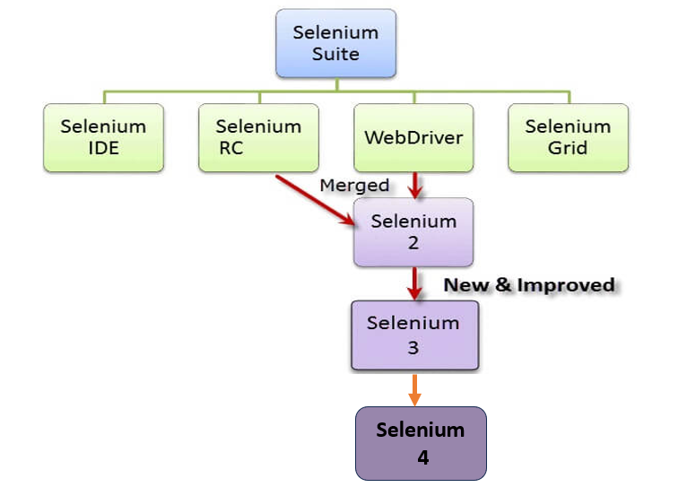
Selenium Suite

Slide 8

Who developed Selenium?
Primarily, Selenium was created by Jason Huggins in 2004. An engineer at ThoughtWorks, he was working on a web application that required frequent testing.
Having realized that the repetitious Manual Testing of their application was becoming more and more inefficient, he created a JavaScript program that would automatically control the browser's actions.
He named this program as the "JavaScriptTestRunner“. Seeing potential in this idea to help automate other web applications, he made JavaScriptRunner open-source which was later re-named as Selenium Core.

Slide 9
The Same Origin Policy Issue
Same Origin policy prohibits JavaScript code from accessing elements from a domain that is different from where it was launched.
Example, the HTML code in www.google.com uses a JavaScript program "randomScript.js". The same origin policy will only allow randomScript.js to access pages within google.com such as google.com/mail, google.com/login, or google.com/signup.
However, it cannot access pages from different sites such as yahoo.com/search or guru99.com because they belong to different domains.

Slide 10

Birth of Selenium Remote Control (Selenium RC)
This is the reason why prior to Selenium RC, testers needed to install local copies of both Selenium Core (a JavaScript program) and the web server containing the web application being tested so they would belong to the same domain
So another ThoughtWork's engineer, Paul Hammant, decided to create a server that will act as an HTTP proxy to "trick" the browser into believing that Selenium Core and the web application being tested come from the same domain. This system became known as the Selenium Remote Control or Selenium 1.

Slide 11

Birth of Selenium Grid
Selenium Grid was developed by Patrick Lightbody to address the need of minimizing test execution times as much as possible. He initially called the system "Hosted QA." It was capable of capturing browser screenshots during significant stages, and also of sending out Selenium commands to different machines simultaneously.

Slide 12

Birth of Selenium IDE
Shinya Kasatani of Japan created Selenium IDE, a Firefox extension that can automate the browser through a record-and-playback feature. He came up with this idea to further increase the speed in creating test cases. He donated Selenium IDE to the Selenium Project in 2006.

Slide 13

Birth of WebDriver
Simon Stewart created WebDriver circa 2006 when browsers and web applications were becoming more powerful and more restrictive with JavaScript programs like Selenium Core. It was the first cross-platform testing framework that could control the browser from the OS level.

Slide 14
Birth of Selenium 2
In 2008, the whole Selenium Team decided to merge WebDriver and Selenium RC to form a more powerful tool called Selenium 2, with WebDriver being the core. Currently, Selenium RC is still being developed but only in maintenance mode.
So, Why the Name Selenium?
It came from a joke which Jason cracked one time to his team. Another automated testing framework was popular during Selenium's development, and it was by the company called Mercury Interactive (yes, the company who originally made QTP before it was acquired by HP). Since Selenium is a well-known antidote for Mercury poisoning, Jason suggested that name. His teammates took it, and so that is how we got to call this framework up to the present

Slide 15

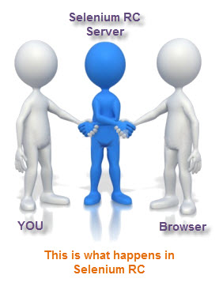

Slide 16
Features of Selenium
Following are the features of Selenium:
Open Source Availability
Multi-Browser support
Support Various Language and Frameworks
Support Various Platforms
Ease of Implementation
Flexibility – Support many third party plug.in / tools
Parallel Test Execution and Faster go to Market
Less Hardware Usage.

Slide 17
Limitations of Selenium
Selenium cannot extend support to the Window based applications, it only works on the Web based applications.
Selenium is not capable of performing mobile automation on its own. (Appium tool is used for mobile app testing)
Selenium does not have any inbuilt reporting feature.
Selenium does not automate captcha.
Selenium does not automate barcodes.
Selenium does not automate test cases on fingerprints.
Selenium depends on third party frameworks like Junit, TestNG, Cucumber for the Reporting purpose
Selenium is open source, so in case of issues there is no prompt vendor assistance.
Selenium users need to be aware of some programming languages.

Slide 18
Limitations of Selenium
Selenium users do not find it easy to set up a test environment compared to the licensed tools like UFT, reporting.
Selenium cannot perform testing for the images.
Selenium users need a subsequent amount of time for test case authoring.
Selenium does not support automation testing of video and audio.
Selenium does not give provision of running parallel tests from one computer.

Slide 19
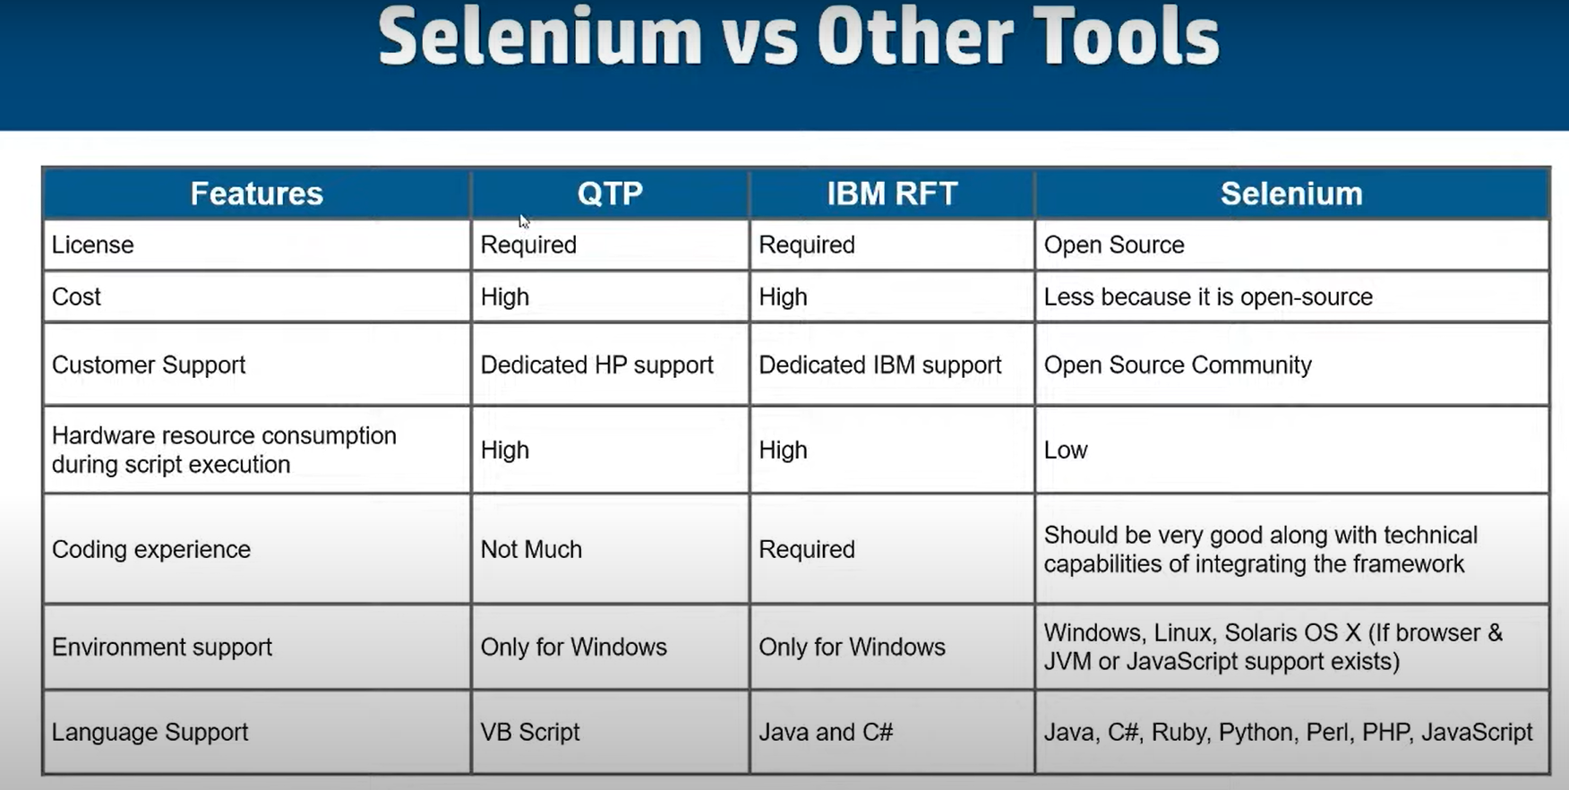

Slide 20
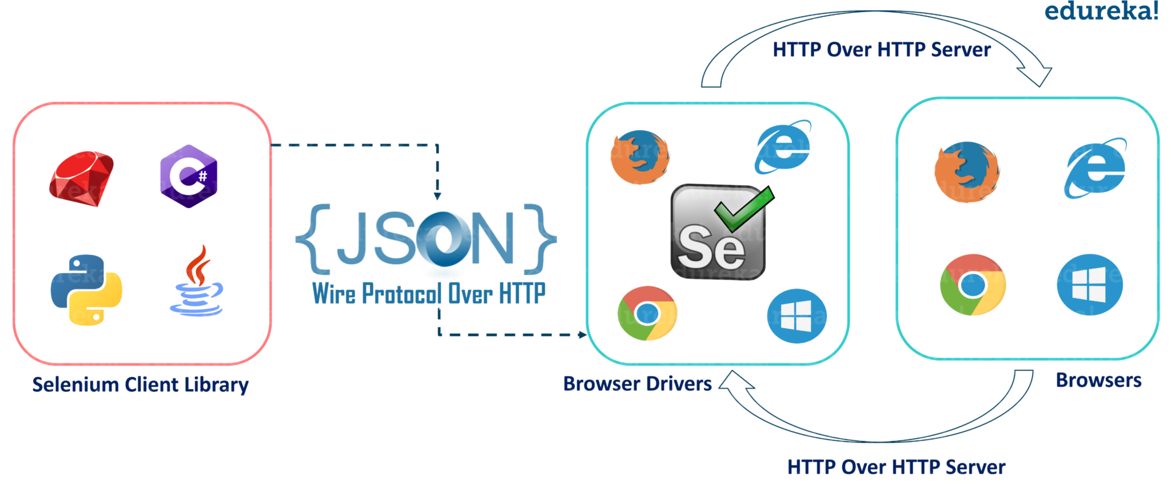
Selenium 3 WebDriver Architecture

Slide 21
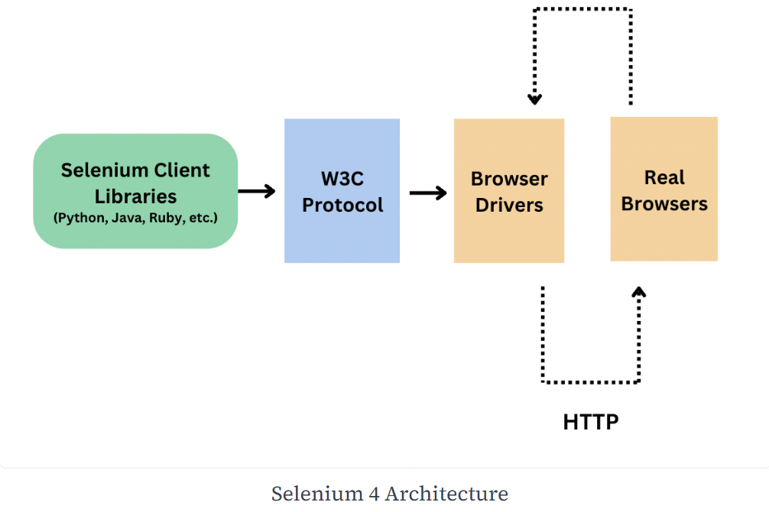
Selenium 4 WebDriver Architecture

Slide 22
Selenium IDE
It is Record and Playback tool

Slide 23
Pros and Cons of Selenium IDE
Pros:
Selenium IDE is very easy to use.
It has the capability to convert the test to different programming languages such as html, java etc
Programming language experience is not required for Selenium IDE
Selenium IDE provides Logging capabilities using file login plug-in.
In Selenium IDE, user can debug and set breakpoints
Selenium IDE is flexible for the users.
Cons:
Not suitable for testing extensive data
Connections with the database can not be tested
Cannot handle the dynamic part of web-based applications
Does not support capturing of screenshots on test failures
No feature available for generating result reports
Useful for demo or proof-of-concept tests

